Slide 1
The Holy Spirit described as Oil
Hebrew = Shemen
Greek = Elaion

Slide 2
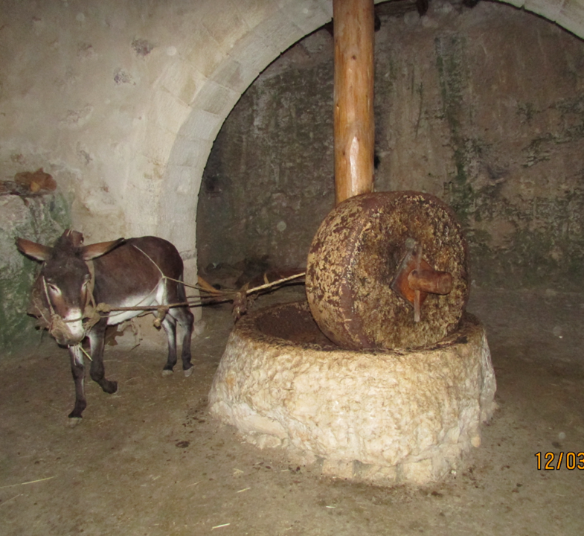
Three grades of oil
EVOO = extra virgin oil, the first ground and collected – temple
Ordinary Olive Oil = used for cooking
Pomace oil (opo) = left over oil used for grease, etc.

Slide 3
Old Testament use:
Exodus 30: 29 = Connected to an “anointing”, represents the power and presence of the Holy spirit, to set apart and to consecrate
Lev. 2:1-2 = grain offerings – oil and incense poured on the grain, burnt as a memorial of God’s power and presence

Slide 4
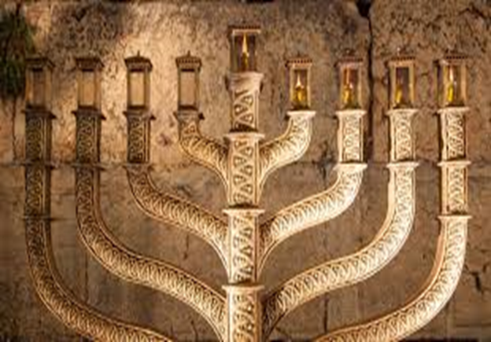
The menorah
Always had to filled with oil as a a representation of the “Light” – Jesus said, “I am the Light of the world”
It is the oil (Holy Spirit) who empowers the light…

Slide 5
OLD TESTAMENT USE OF “YITSHAR” = FRESH OIL SAME CONCEPT AS “NEW WINE”
ANOINTING THE PERSON WITH OIL = DAVID – A GOOD EXAMPLE,
I SAMUEL 16 AND PSALMS 23: 5
NOT FOR SIN OFFERINGS
MEDICINAL PURPOSES = ISAIAH 1:6
OIL OF GLADNESS = ISAIAH 61: 3 – the oil of joy instead of sorrow
OIL TO BRING UNITY = PSALMS 133 – OIL POURED FROM MT HERMON DOWN TO MT ZION

Slide 6
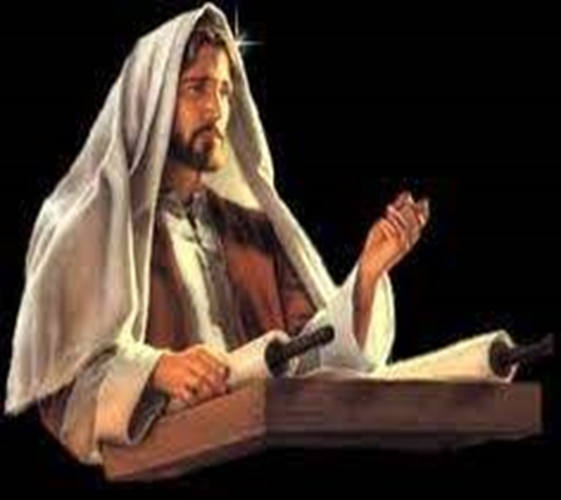
In luke 4:18, Jesus read Isaiah 61: 1 & 2
“The Spirit of the Lord is on me, because he has anointed me to proclaim good news to the poor, He has sent me to proclaim
freedom for the prisoners, and recovery of sight to the blind, to set the oppressed free, and to proclaim the year of the lord’s favor.”

Slide 7
New Testament use:
Matthew 25: 1 – 13 5 wise virgins and the 5 foolish virgins:
The oil must be given individually
The oil cannot be given from one another
The oil cannot be borrowed
This is a parable of their relationship with the bridegroom
For the 5 foolish – the sacred became profane (unholy)

Slide 8
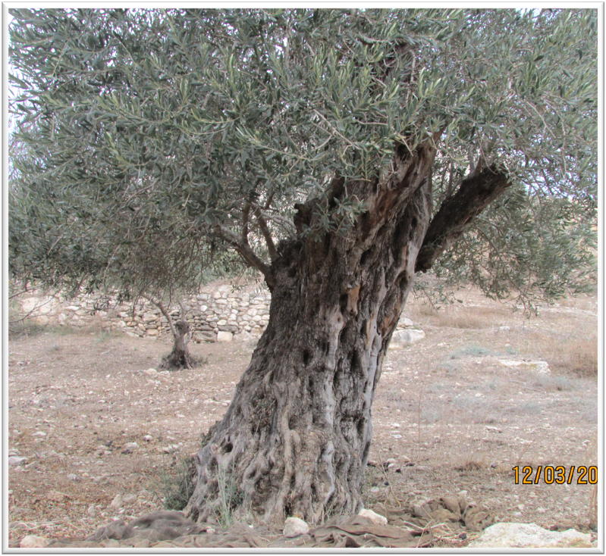
Mt of olives = named for the many olive trees and presses on the mountain
Roots seem eternal
Garden of gethsemane = Hebrew meaning oil press

Slide 9
The Messiah Acts 10: 36 & 38
“You know the message God sent to the people of Israel, announcing the good news of peace through Jesus Christ, who is Lord of all…how God anointed Jesus of Nazareth with the Holy Spirit and power, and healing all who were under the power of the devil because God was with Him.”

Slide 10
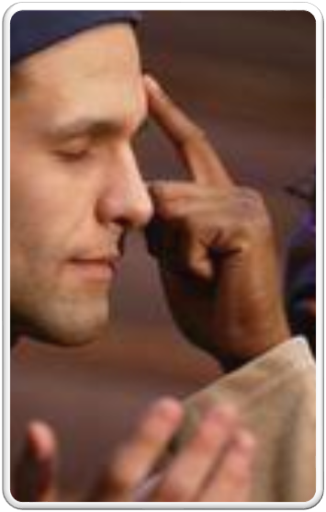
James 5: 14 & 15
“Is anyone among you sick? Let them call the elders of the church to pray over them and anoint them with oil in the name of the lord. And the prayer offered in faith will make them well; the lord will raise them up…”

Slide 11
Summary
When the Holy Spirit is upon us:
Like Jesus – we will proclaim the good news
We will have power to be witnesses and overcome sin and temptation
We become instruments of healing

