Slide 1
Paul & Barnabas’ 1st Missionary Journey
Acts 13b & 14

Slide 2
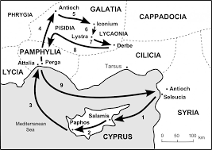
From Paphos to Perga in the region of Pamphylia
John Mark returns home to Jerusalem
Paul and Barnabas continue to Antioch #2 – in the Pisidia region

Slide 3
A Pattern of sharing the Gospel is established:
First to the Synagogue (“church” - Temple is in Jerusalem)
Went in, sat down, did not call attention to themselves
The Leaders of the Synagogue noticed their visitors and asked if they (Paul and Barnabas) had “words of exhortation to share” – testimony
Paul stood up… (the crowd was mixed with both Jewish and Gentile followers of the Jewish religion and practices)

Slide 4
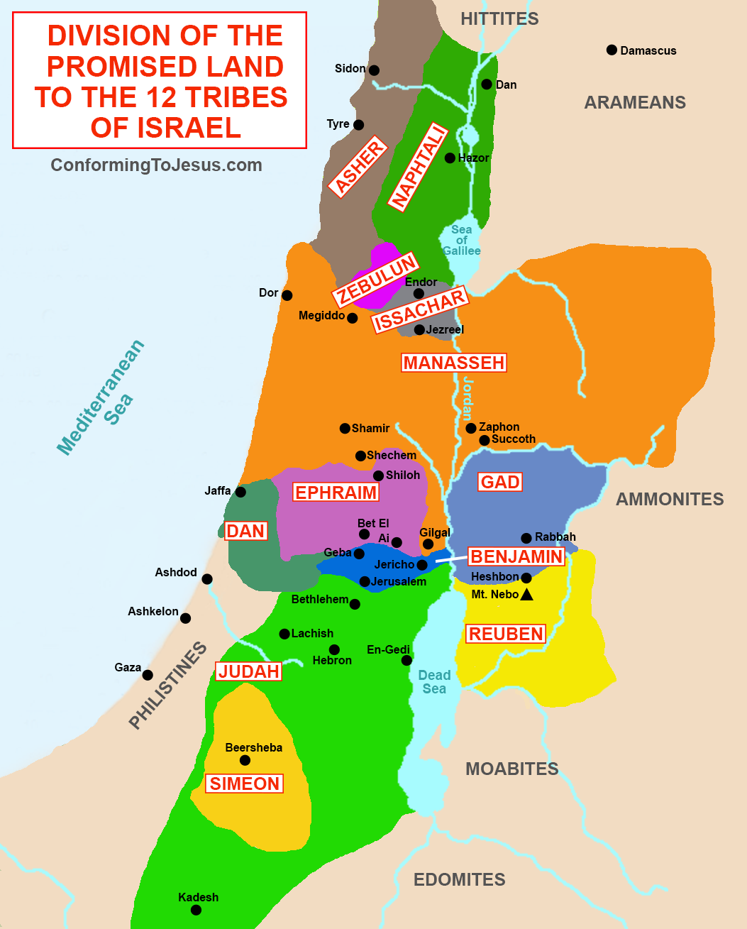
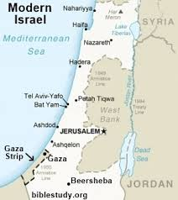
Paul first gave a historical context:
God chose Abraham’s Ancestors:
In Egypt/slavery, they prospered
His mighty power freed them
He cared for them in the wilderness – 40 years
He overthrew 7 nations in Canaan for them to inherit the Promise Land
All of this took about 450 years

Slide 5
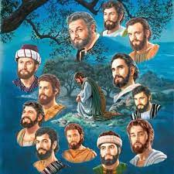
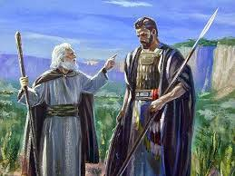
God sent many prophets to guide Israel – God was their King!
But they wanted to be just like everyone else…
They chose Saul, taller than the others, handsome…but insecure…infirmities lead to his destruction…
He hid when they were looking to crown him
He was very jealous of David’s victories
Cruel to Israel and to his son
Disobeyed God and Samuel several times
Eventually, killed himself…

Slide 6
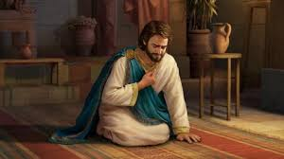
Then came David – Tribe of Judah – The Lion of Judah chosen by God
God chose because David worshiped God with all his heart
God called David, “A man after My own heart” – God’s friend
And because he did everything God asked him - obedient

Slide 7
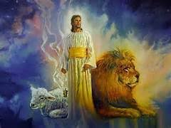
From King David, God brought to Israel the Savior Jesus
It was to Abraham’s family and God-fearing Gentiles who God sent the message of salvation
The Jews and rulers did not realize that they were fulfilling prophecy by crucifying Jesus
Jesus rose from the dead forgiving all our sins
Jesus lives today!

Slide 8
They were beat-up and kicked out of Pisidian Antioch – left filled with joy and the Holy Spirit!
Ch
a
p
t
e
r
14
From Antioch in Pisidia – 2 Antiochs (Syria and Pisidia) they went to Iconium
Followed same pattern – synagogue first and a great number accepted Jesus as a result of their preaching/teaching
The non-believing Jews poisoned the minds of the Gentiles
God confirmed His Word by enabling them to do signs and wonders

Slide 9
The message of Jesus will often divide people
A plot to persecute Paul & Barnabas stirred; they escaped and went to Lystra and Derbe
In Lystra, the Lord healed a man who was crippled from birth. Paul looked at him and said, “Stand up…” and he jumped up and walked!

Slide 10
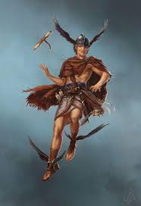
People of Lystra ran to what they understood… Greek mythology
Paul and Barnabas tour their robes and cried out, “We are human like you!”
Msg: God let the nations choose their way but never forsaken them – breathe, rain, joy, etc.
z
Barnabas = Zeus
Paul = Hermes

Slide 11
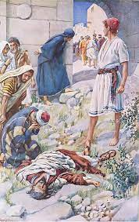
Trouble followed!
z
Jews from Antioch (P) and Iconium came to Lystra and caused stir/conflict
They dragged Paul out of the city and stoned him – until they thought he was dead
The believers/disciples gathered around him, he rose up, returned to the city then left the next day

Slide 12
In Derbe…
Preached and taught in Derbe, many accepted Jesus as their Savior
Then they returned to Lystra, Iconium, Antioch to appoint & strengthen the new leaders –after prayer and fasting
Returned to Antioch of Syria – completing their task
z

Slide 13
Ponder…
z
Msg of Jesus divides…
He confirms His work with signs and wonders
When ‘worshipped’ – they tour their robs…
God still gives mankind a choice – free will, breathe life, food, water, & joy
“We must go through many hardships to enter the kingdom of God.” 14: 22

