Slide 1
Cost of obedience
Acts 21: 1 - 16

Slide 2
What are you willing to pay for something/someone extremely important to you?
*Pearl of great price – Matthew 13
*You! I Corinthians 7: 23 “You were bought at a price…”
What price have you – finish – pay and are now paying to live obedient to Jesus?

Slide 3
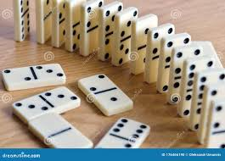
obedience
In your life - effects everything!

Slide 4
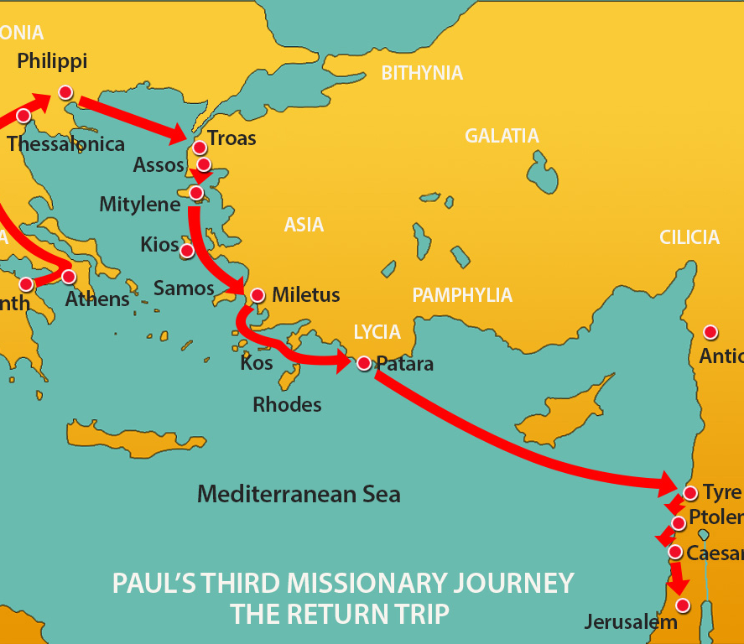
Acts 20: 1 – 16 Paul on his way to Jerusalem
From Miletus to Kos to Rhodes to Patara to south of Cyprus…Paul stood on the ship’s deck … watching as they sailed pass Cyprus – a flood of memories and emotions must have hit Paul…

Slide 5
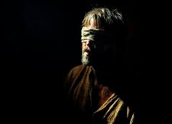
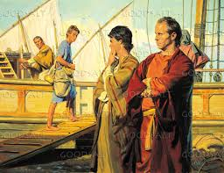
The home of Barnabas –
Paul’s mentor and dear friend
The place of his 1st missionary
journey…
Where Simon the magician was
blinded…
John Mark abandoned us
Causing Barnabas and Paul to separate
Was Barnabas still alive? Not sure…he died 61ad
So much to remember…

Slide 6
V4-6 They landed in Tyre and stayed for 7 days with the believers of Tyre
They begged Paul not to go to Jerusalem…what a scene…All the believers - men, women, and children went with Paul to the boat
Sailed to Ptolemaes then to Caesarea…

Slide 7
Caesarea then to Jerusalem…v7-16
In Caesarea with Philip (one of the first 7 Deacons – Acts 6:5) and his 4 unmarried daughters who were prophets
We meet the prophet named Agabus, took Paul’s belt and tied his own feet and hands – saying Paul will be bound by the Jews and given to the Gentiles…not exactly what happened … but… they begged Paul not to go to Jerusalem
Paul responded, “Why are you weeping and breaking my heart? I am ready to be bound and to die for the Lord Jesus.”
Couldn’t change his mind, they said, “The Lord’s will be done…”

Slide 8
A group of believers from Caesarea went with Paul to Jerusalem where the stayed with Mnason – a believer from Cyprus…
Jerusalem…

Slide 9
Reflections of your obedience…
What has the Lord asked you to do? What legacy of obedience will you be leaving for others to “heard heard heard”???

