Slide 1
Intro to the History & Theology of the Assemblies of God
THEO 233D

Slide 2
Ag.org

Slide 3
The Start
Between the Civil War and the close of the 1800’s – conditions
Fundamentalists and the Holiness Movement

Slide 4
Bethel Bible College
Director: Charles Parham
Topeka, KS – January 1, 1901
13 students in a barn – praying and fasting
Agnes Ozman
Initial physical evidence – speaking in tongues

Slide 5
W. J. Seymour
Trained in the ministry by sitting outside a classroom window as Charles Parham taught – Texas
1906 – secured a building at 312 Azusa St. in Los Angeles, CA
Services from 10 am – midnight everyday for 3 years.

Slide 6
Publication: Word and Witness – E. N. Bell
For information, teaching and organizing the movement
Called for a conference in Hot Springs, Ark in 1914
300+ people attended
The Assemblies of God birthed – E. N. Bell elected the first Chairman of this new fellowship

Slide 7
Why? 5 Reasons
Better understanding and unity of doctrine
To know how to conserve God’s work at home and abroad (other countries)
To consult on protection of funds for missions
To help charter churches under a legal name
To consider the establishment of a Bible training school with a literary division.

Slide 8
Doctrine Established
16 Fundamental Truths of the Assemblies of God – 1916
1961 – Position Papers called “Where We Stand”
Commission of Doctrinal Purity – 1990’s

Slide 9
The Scriptures Inspired
1st Fundamental Truth of the A/G

Slide 10
The Authoritative Rule: “The Scriptures, both the Old and New Testament are verbally inspired of God and are the revelation of God to man, infallible, authoritative, rule of faith and conduct.”
Three kinds of religious authority:
A) human reasoning = rationality (the quality of being based on or in accordance with reason or logic) vs. rationalism (reliance of reason to validate religious truth)
B) the Church = apostolic succession (Peter)
C) God’s Word = Hebrews 1: 1 – 2

Slide 11
The Revelation of God to Humankind
A) Natural/General Revelation: Romans 1:20, “Since the creation of the world God’s invisible qualities – His eternal power and divine nature – have been clearly seen, being understood from what has been made, so that men are without excuse.”
B) Conscience: Romans 2: 14-15, “Indeed, when Gentiles, who do not have the law, do by nature things required by the law for themselves, even though they do not have the law, since they show that the requirements of the law are written on their hearts, their consciences also bearing witness, and their thoughts now accusing, now even defending them.”

Slide 12
Verbally Inspired Word of God
2 Timothy 3:16-17, “All Scripture is God-breathed and is useful for teaching, rebuking, correcting and training in righteousness, so that the servant of God may be thoroughly equipped for every good work.”
“theopneustos” = Hebrew meaning “God-breathed”. This is not “dictation” – God spoke sometimes audibly, sometimes through the heart/mind Spirit, etc. The Spirit illuminates the mind of the writer and reader.

Slide 13
2 Peter 1: 16-21, “For we did not follow cleverly devised stories when we told you about the coming of our Lord Jesus Christ in power, but we were eye witnesses of His majesty. He received honor and glory from God the Father when the voice came to Him from the Majestic Glory, saying, ‘This is my Son, whom I love; with Him I am well pleased.’ We ourselves heard this voice that came from heaven when we were with Him on the sacred mountain (transfiguration)…

Slide 14
2 Peter 1 continued: “We also have the prophetic message as something completely reliable, and you will do well to pay attention to it, as to a light shining in a dark place, until the day dawns and the morning star rises in your hearts. Above all, you must understand that no prophecy of Scripture came about by the prophet’s own interpretation of things. For prophecy never had its origin in the human will, but prophets, though human, spoke from God as they were carried by the Holy Spirit.”

Slide 15
Jesus fully accepted the Torah (OT) in John 10:35, “Scripture cannot be broken.” Also, look at Matt. 5:18, “Until heaven and earth disappear, not the smallest letter, not the least stroke of a pen, will by any means disappear from the Law until everything is accomplished.”
Plenary Verbal Inspiration:
Plenary = “full”
Verbal = “spoken/inspired”
Inspiration = discussed earlier
The A/G holds strongly to the plenary verbal inspiration of Scriptures – it’s message is absolute truth.

Slide 16
Peter’s view of Paul’s writing…
2 Peter 3: 15-16, “Bear in mind that our Lord’s patience means salvation, just as our dear brother Paul also wrote you with the wisdom that God gave him. He writes the same way in all his letters, speaking in them of these matters. His letters contain some things that are hard to understand, which ignorant and unstable people distort, as they do other Scriptures, to their own destruction.”

Slide 17
The Infallible Rule
Infallible = “incapable of error and therefore not capable of misleading, deceiving, or disappointing us.” (p. 26)
Inerrancy = “exempt from error”- to the A/G, scriptures are not inerrant.
A/G strongly supports the infallibility of God’s Word but recognizes recording/statistical errors are possible.
“The whole Bible shows that He is reliable, dependable, trustworthy, and His very nature guarantees the authority and infallibility of His Word.”

Slide 18
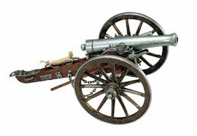
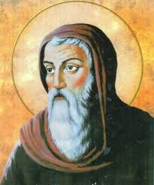
T The Canon & Later Translations
Canon = a rule, a standard, a measuring rod
39 Old Testament Canons – already established by the time of Jesus’ incarnation (God in human form)
367 ad – Athanasius examining documents circulated discovered there were 27 NT books/letters/canons
397 ad Council of Carthage
declared the NT had 27
books

Slide 19
4 NT Criteria:
Apostolicity = writer an apostle or one who had seen Jesus?
Universality = was the book widely accepted by the Church?
Contents = writings consistent with OT and other NT texts?
Inspiration = does the writing have the divinely inspired quality as the other accepted books have?

Slide 20
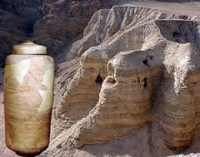
Dead Sea Scrolls
Discovered in 1947 by a shepherd boy
All or parts of all 39 OT canons – except for the Book of Esther – were discovered – Hebrew text
Dated as early at 250 BC
250 bc – 150 bc =
Septuagint Version - Greek

Slide 21
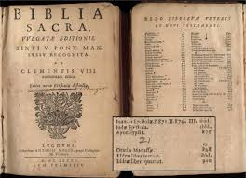
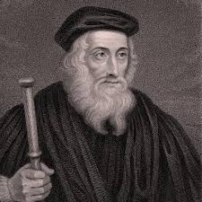
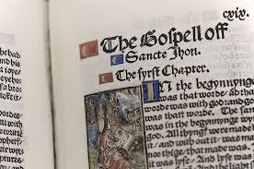
Changing Translations
312-320 ad = Jerome (Church Father) and 300 other priests/translators translated the entire 66 books into Latin – called the Vulgate
1380 ad = John Wycliffe translated the first English Bible. He died in 1384 ad. Roman Catholic Church condemned his work and by 1428 – most of his handwritten copies were burnt.

Slide 22
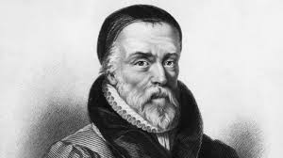
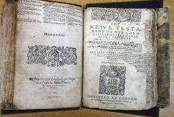
Printing press – 1440 helped spread the Word
1462 – 1522 = at least 17 translations of the Bible were found in Germany
Martin Luther influenced William Tyndale who made the first most important English translation of the NT in 1525. Tyndale was arrested by the RC Church and burned at the stake.
Geneva Bible = English translation written by English refugees who fled to Switzerland – brought to America by the Pilgrims.

Slide 23
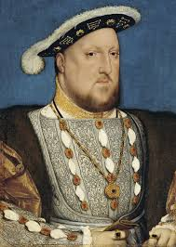
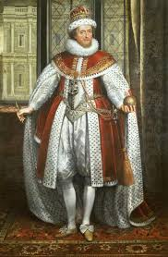
KJV
King Henry VIII – broke off from the Catholic church and created the Church of England (Episcopal) 1530’s – varying translations were used
King James I appointed several groups of Biblical scholars who wrote the KJV in 1611. It was King James who “authorized” this version.
This was during the time when Shakespearian English was very popular so that is what the translators used…

Slide 25
The One True God
2nd Fundamental Truth of the A/G

Slide 26
“The one true God has revealed Himself as the eternally self-existent ‘I AM’, the Creator of heaven and earth and the Redeemer of mankind. He has further revealed Himself as embodying the principles of relationship and association as Father, Son, and Holy Spirit.”
Deut. 6:4
Isaiah 43: 10-11
Mark 28: 19 and Luke 3:22

Slide 27
In Response to a 1913 Heresy…1916 “The Adorable Godhead”
Terms Defined = Trinity (although not used in scriptures) and Persons of the Godhead are in harmony with Scriptures. Matt. 28: 19
Distinction and Relationship in the Godhead = Jesus identified the Godhead in the terms of Father, Son, and Holy Spirit. 2 Cor. 13:14
Unity of the One Being of Father, Son, and Holy Spirit = Father-Begetter; Son-Begotten; Holy Spirit-the One proceeding from the Father & Son. Zech 14:9; John 1: 18

Slide 28
Identity and Cooperation in the Godhead = The Father is not from the Son – the Son is from the Father; the Holy Spirit is from the Father and the Son proceeding – hence, neither Person in the Godhead exists or works separately or independently of each other. John 5: 17-30, 32 & 37
The Title, Lord Jesus Christ = belongs exclusively to the Son of God only. Romans 1: 1-3, 7; 2 John 3
The Lord Jesus Christ, God with Us = The Son of Man, both God and man – Immanuel. His time on earth. Matt 1:23; Rev 1: 13 & 17.
The Title , Son of God = eternal

Slide 29
The Existence of God
Ontological view = because god does not have a physical existence – he is imperfect and therefore non-existent
Cosmological view = the First Cause
Teleological view = Divine Designer
Moral view = every human being has a stamp of right and wrong that is higher than his/her existence therefore there is a god.

Slide 30
Attributes
Omnipotence = almighty
Omnipresent = all present
Omniscient = all knowing
God is good
God is love
God is holy
God is righteous

Slide 31
The Deity of the Lord Jesus Christ
3rd Fundamental Truth of the A/G

Slide 32
The Lord Jesus Christ is the eternal Son of God
His virgin birth = Matt 1:23; Luke 1: 31 & 35
His sinless life = Heb 7:26; 1 Peter 2:22
His miracles = Acts 2:22 & 10:38
His substitutionary work on the cross = I Cor 15:3 & 2 Cor 5:21
His bodily resurrection from the dead = Matt 28:6; Luke 24: 39; I Cor 15: 4
His exaltation to the right hand of God = Act 1: 9 &11; Acts 2:33; Phil 2: 9- 11; and Heb 1:3.

Slide 33
THE OFFICES OF CHRIST:
Prophet = the anointed Servant = Is. 11:2
Priest = Heb 8:3
King = Rev. 5: 6- 13

